Slide 1
Continuous Detection of Traumatic Brain Injury (TBI) and Stress
Brittney Haselwood
Biomedical Engineering
Mentor: Jeffrey La Belle, Ph. D

Slide 2
Background: TBI Statistics
TBI is responsible for at least 1.7 million deaths and disabilities in the U.S.
According to the CDC, annual TBI’s cause:
52,000 deaths (1/3 of injury-related deaths in U.S. annually)
275,000 hospitalizations
1,365,000 visits to emergency/urgent care
Annual costs of TBI
$60 billion in 2000
$76.5 billion in 2010 ($45,000/person)
"CDC - Statistics - Traumatic Brain Injury - Injury Center." Centers for Disease Control and Prevention. 5 May 2011. Web. 04 Nov. 2011. <http://www.cdc.gov/traumaticbraininjury/statistics.html>.
Notes:
How TBI occurs: closed injury (causes brain to hit skull): whiplash, blunt object hit, and penetrating (object enters skull and pierces brain) gun shot, sharp object
**Perhaps talk about how much cost this is in comparison to other disease like diabetes???
75% injuries are mild

Slide 3
Background: TBI Outcomes
Depending on Severity, TBI can affect:
Thinking, Sensation, Language, Emotion
Other Effects of TBI
May cause epilepsy and predisposition for Alzheimer's and Parkinson’s Diseases
Danger in no treatment:
Extended TBI: accumulating neurological and cognitive deficits
Many TBI’s sustained in short succession: fatal
"CDC - Potential Long-term Outcomes - Traumatic Brain Injury - Injury Center." Centers for Disease Control and Prevention. 8 Mar. 2010. Web. 04 Nov. 2011. <http://www.cdc.gov/TraumaticBrainInjury/outcomes.html>.
Notes:
Thinking- memory and reasoning Sensation- touch, taste, smell Language- communication, expression, and understanding Emotion- depression, anxiety, personality changes, and aggression
May cause epilepsy and predisposition for Alzheimer's and Parkinson’s Diseases (especially seen in older people who sustain TBI)

Slide 4
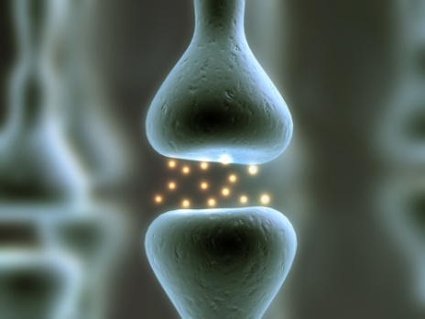
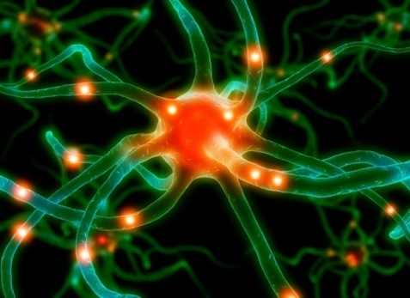
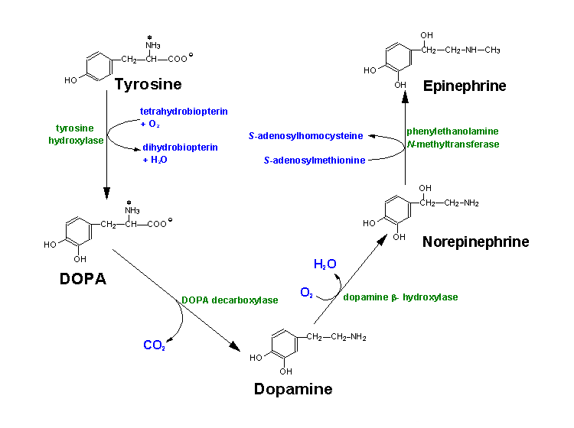
Background: Catecholamines
Why Catecholamines?
Human Catecholamine Metabolic Pathway
Neurotransmitters cause neuron firing = communication
Catecholamines are neurotransmitters (Stimulate Sympathetic Nervous System). Catecholamines are involved in other functions such as inflammation response.
Asymptomatic Physiological Levels of Catecholamines:
DA: 98 ± 20 pg/mL
EP: 64 ± 5 pg/mL
NE: 203 ± 10 pg/mL
Bühler et al., 1978
Goal:
To create an efficient multi-marker sensor which continuously measure how much stress a person is experiencing based on measurements of the catecholamines (Dopamine, Epinephrine and Norepinephrine), and metabolism of important molecules such as glucose and lactate
Plan of Action:
To select an enzyme whose substrate is one of the biomarkers (catecholamines and sugars) . A subcutaneous sensor will be fabricated with these enzymes to be highly sensitive and specific to the biomarkers at blood plasma levels.
Images: (Left) http://www.primalbody-primalmind.com/wp-content/uploads/2009/07/neurotransmitter_home1.gif; (Middle) http://www.photaki.com/picture-neuron-human-biological-human-biological_150125.htm; (Right) http://themedicalbiochemistrypage.org/aminoacidderivatives.html ; Silverthorn, D.U., 2004, Human Physiology: An Integrated Approach, fifth edition. San Francisco: Pearson, 2010.

Slide 5
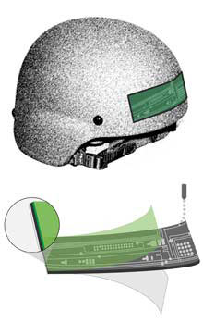
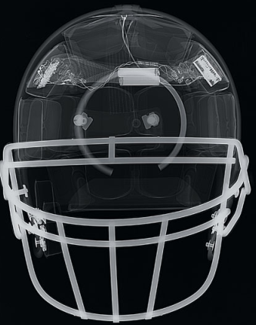
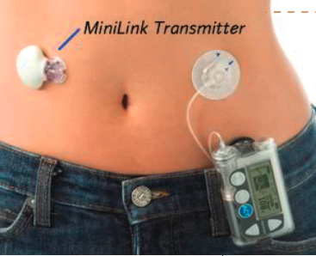
Background: Current Sensors SOTA (State of the Art) TBI and related Sensors
Intracranial Pressure Sensors
Parc’s Flexible printed sensor tape
to diagnose mild TBI
External Pressure Sensors
Military helmets
Football helmets (Dartmouth)
Protein Sensors
Center for Nano-Bio Sensors
(ELISA Sensor)
Medtronic Continuous Glucose
Monitoring Insulin Pump
Notes:
According to the Army Medical Department in 2006, the Army created a taskforce to promote preventative measures for TBI and provide treatment for soldiers who sustained TBI in the Middle East.
Advantages to these sensors: 1- sensitive to what is going on internally; 2- non-invasive; 3 & 4- sensitive and minimally invasive (4 is continuous with drug delivery)
Disadvantages to these sensors: 1- Protein sensor: From the University of Florida uses antibody-bound nanoparticles to detect brain injury in plasma and spinal fluid. This uses the ELISA technique in a hand-held device, slightly larger than a graphing calculator.

Slide 6
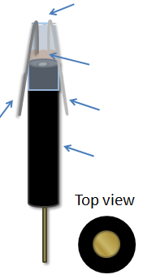
Electrode Set Up
Working Electrode: Gold Disk
Where signal is transduced
Counter Pt Electrode
Where the signal is generated
Reference Ag/AgCl Electrode
Serves as reference for electrochemical reaction and ground for circuit analysis
Use of Electron Mediator in sample (Redox Probe)
Cut Pipette tip
Sample
Pt Counter Electrode
Ag/AgCl Reference Electrode
Gold Disk Electrode

Slide 7
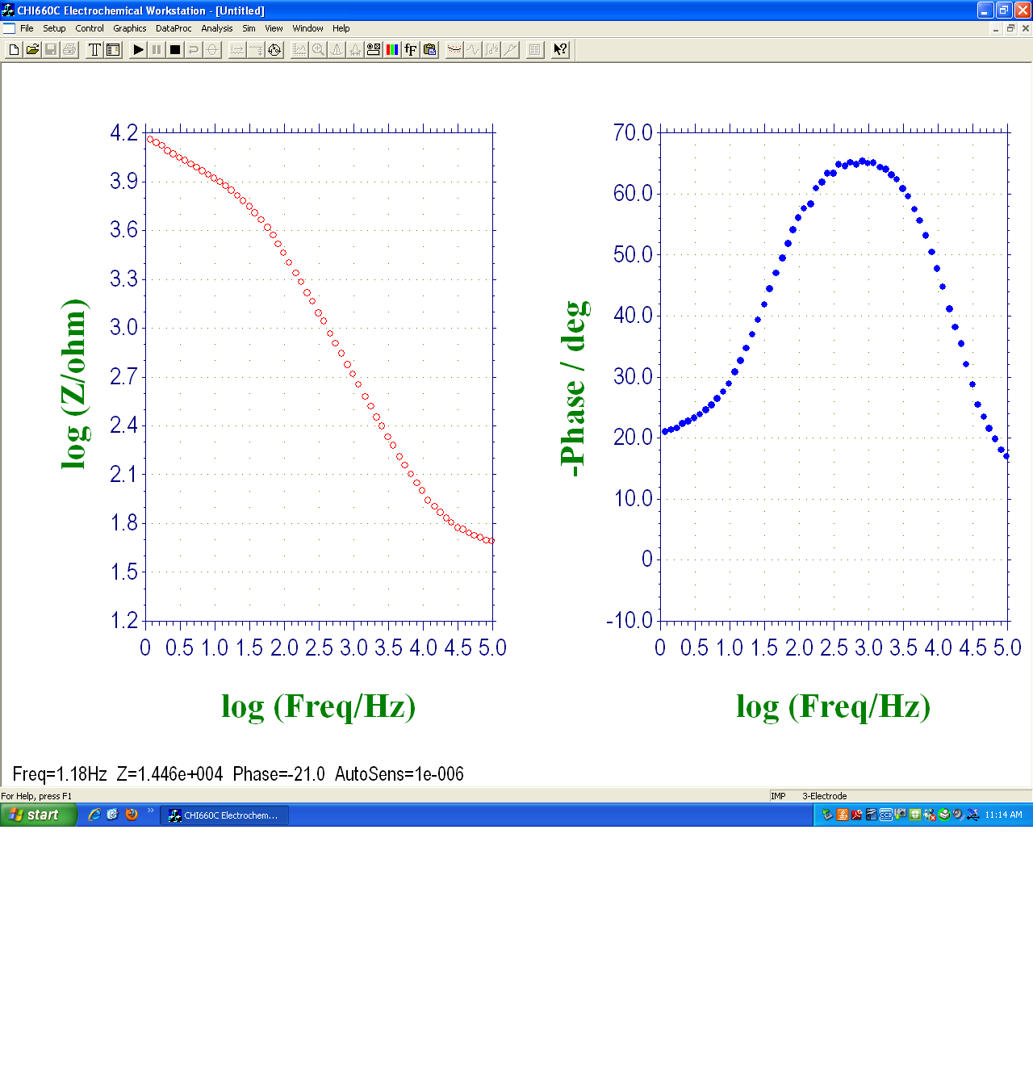
Electrochemical Impedance Spectroscopy (EIS) Background
High freq
Low freq
Signal Input at one voltage:
What is measured:
time
Z ~ Change in magnitude
Impedance, Z (ohm)
Time (s)
Log Frequency (Hz)
INPUT
OUTPUT
Phase, Phi (degree)
φ = Change in phase
La Belle, E. Chem. 101. 2011.
Log Frequency (Hz)
Notes:
The Input signal is an AC frequency sweep at one defined voltage

Slide 8
Goals in Creating a Subcutaneous Continuous Sensor
Quick Response Time
Multiplexable
Low limit of detection (High Sensitivity)
High Specificity
Low cost
User-friendly
Notes:
Explain multiplexable

Slide 9
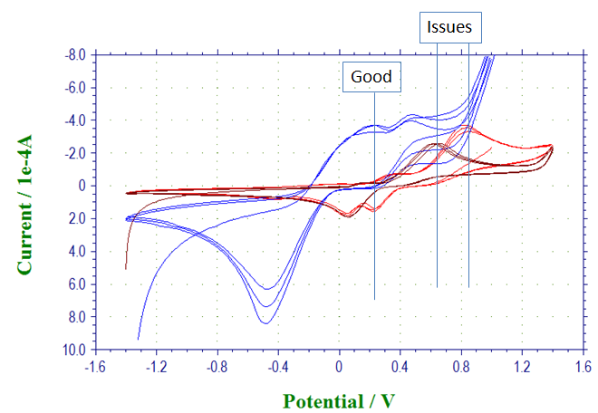
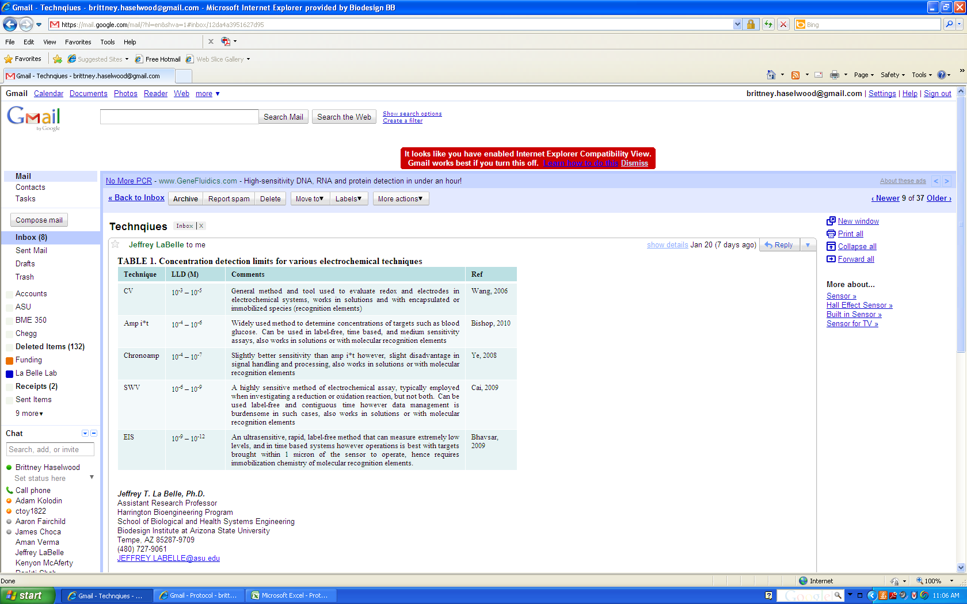
Problems with Current Electrochemical Techniques
Not sensitive enough
Most are not continuous
Not user-friendly
DAHCl: 5.27*10⁷
pg/mL; V=0.6V
EP: 5.09*10⁷ pg/mL;
V=0.2V
NE: 5.92*10⁶ pg/mL;
V=0.8V
10⁻³–10⁻⁵
Figure 1. CV of Epinephrine (blue), Norepinephrine (maroon), and Dopamine (red). In future, a single sensor will have issues with amplification/convolution of signal; it is hard to say, specifically, which catecholamine’s peak is associated with these potentials. The epinephrine peak at 0.2V has minimal noise.
10⁻⁴–10⁻⁶
10⁻⁴–10⁻⁷
10⁻⁶–10⁻⁹
Table 1. The table at left describes the common techniques and their sensitivities.
10⁻⁹–10⁻¹⁵
La Belle, E. Chem. 101. 2011.
Notes:
Note Diversity of applications by changing out proteins in the needles
Potentially wireless for fighter pilot or out-patient monitoring
Feasibly integrated with an automatic Drug Delivery System to counteract inflammation (CONTINUOUS GLUCOSE MONITORING INSULIN PUMP BENCHMARKING)

Slide 10
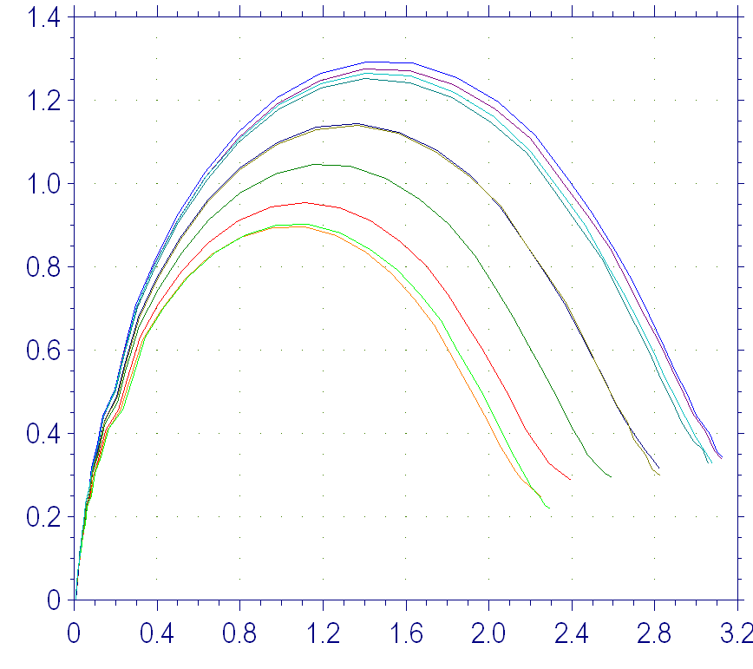
Overview of Solution: Continuous Subcutaneous Monitoring
Using proteins in the body to detect the catecholamines
Enzyme-substrate or Antibody-antigen interactions:
+
=
Protein
Target
Binding Interaction
Cut Pipette tip
Figure at Left. A concentration gradient of Norepinephrine with PNMT Immobilized to Gold surface. This binding event creates a Randles circuit (inlaid).
Sample/
Target
Pt Counter Electrode
Ag/AgCl Reference Electrode
Z” (1E+04 ohm)
Gold Disk Electrode
Cdl
Rs
Ret
Z’ (1E+04 ohm)
Notes:
Working electrode: Site of signal transduction
Counter electrode: Establishes connection to the electrolyte solution
Reference electrode: Maintains stable potential (typically Ag/AgCl)
Advantages to EIS: 90s assay time, insensitive to environmental factors, label-free, modeled using equivalent circuit analysis. Glucose monitors use AMP-it (current v. time), not sensitive enough (mM)

Slide 11
Future Work
Integration/ Multiplexing of the catecholamines
See if all catecholamines can be detected with one sensor
Add in continuous component: Impedance-Time assay
Needle Fabrication (Katherine Ruh)
Test integrated sensor in blood
In vitro testing using polymers and gels
Work on wireless transmission and/or drug delivery integration
Leeching Experiments
Animal tests

Slide 12
Conclusion
Electrochemical Spectroscopy (EIS) is the best technique currently available
sensitive and specific manner using protein immobilized electrodes/needles
Impedance-Time technique
continuous real-time sensor for applications ranging from monitoring stress in fighter pilots while in flight, to monitoring Traumatic Brain Injury in an ICU
Norepinephrine
Epinephrine
Dopamine
Glucose
Lactate

Slide 13
Thank You
Questions?

Slide 14
Extra Slides

Slide 15
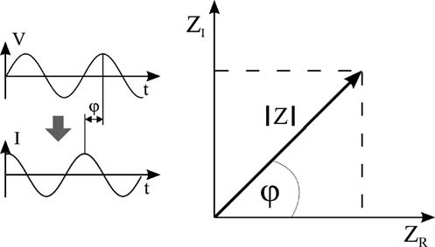
Electrochemical Impedance Spectroscopy (EIS) Background
Graphically
Nyquist Plot
(imaginary impedance)
(real impedance)
Lisdat et al, Bioanal. Chem, 2008
Mathematically
(real impedance)
(imaginary impedance)
Verma, Applied Project Defense. June 2011
and La Belle, E. Chem. 101. 2011.
Notes:
The Nyquist plot is back calculated from the Bode Plot (Magnitude v. Frequency) and the Phase Plot (phi v. frequency)

Slide 16
Solution: Immobilize Protein to Working Electrode
Immobilization Process:
Clean & Hydrophilic substrate
Self-assembling monolayer
Priming Linker for protein attachment
Attaching protein
Ethanolamine: Block unbound carboxyl sites and bare gold (that hasn’t been bound by SAM)
Bare Au Disk Electrode
1 mM 16-MHDA Linker
( 1 hr incubation time)
EDC/NHS Coupling Mechanism (1 hr incubation time)
1% Ethanolamine Blocking Step (30 min incubation time)
1 mg/mL PNMT Immobilization (1 hr incubation time)
Verma, Applied Project Defense. June 2011

Slide 17
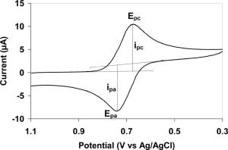
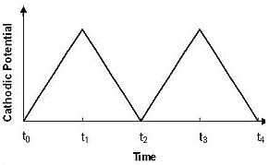
Electrochemical Techniques
Cyclic Voltammetry (CV)
Output
Input
Useful for other techniques:
SWV
Amp i*t
EIS
Formal Potential: Average of Reduction and Oxidation Peak Voltages
La Belle, E. Chem. 101. 2011.
Notes:
Voltage Sweep over time to measure current (not very sensitive), but good for determining electroactivity

Slide 18
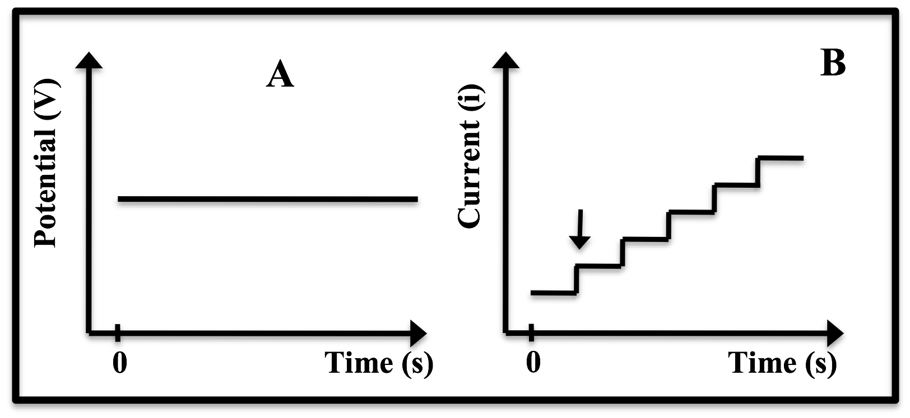
Electrochemical Techniques
Amperometric I-t Curve (AMP-it)
Output
Input
Continuous-time & more sensitive than CV; Technology currently used in SMBGs
La Belle, E. Chem. 101. 2011.
Notes:
Constant Voltage applied over time to measure current. Good for electro-activity determination and degradation studies.

Slide 19
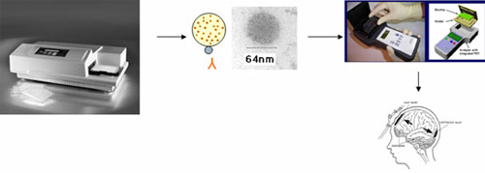
Protein Sensor from the University of Florida
Use of sandwich ELISA (enzyme-linked imunosorbent assay)
Two methods of immobilizing the antigen to the microplate: adsorption or immobilize an antibody (usually different from the antibody which is bioconjugated to the enzyme but is still specific to the same antigen) then add the antigen, then the other antibody, then bioconjugate to the enzyme.
Wang, Dr. Kevin, Dr. Weihong Tan, Dr. Firas Kobeissy, and Dr. Stephen Larner. "Traumatic Brain Injury Nanosensor." Center for Nano-Bio Sensors. UF-CNBS 205 Particle Science & Technology, 10 Oct. 2007. Web. 4 Nov. 2011. <http://cnbs.centers.ufl.edu/research/brain.asp>.
Thermo Scientific. "Introduction to ELISA." Assay Development Technical Handbook. 2nd ed. 2011. 1-7. Thermo Scientific Pierce Protein Research Products. Web. 4 Nov. 2011. <http://www.piercenet.com/Objects/View.cfm?>.
Notes:
ELISA immobilizes an antigen to a microplate then the antibody to the antigen is added to bind to the antigen. To finish the preparation an enzyme is bioconjugated to the antibody. The test procedure includes adding the substrate to the bioconjugated enzyme.
Two methods of immobilizing the antigen to the microplate: adsorption or immobilize an antibody (usually different from the antibody which is bioconjugated to the enzyme but is still specific to the same antigen) then add the antigen, then the other antibody, then bioconjugate to the enzyme.

Slide 20
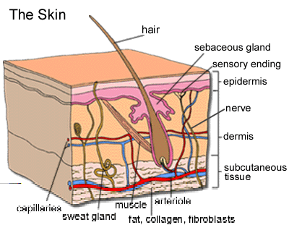
Subcutaneous: Needles
Needle Insertion Issues:
Different thickness of subcutaneous fat
Angle of insertion
Injury currents
Rejection
Possible Solution:
Have multiple holes specially drilled in to minimize discomfort, but have multiple points of detection
Image from: http://www.nku.edu/~dempseyd/SKIN.htm

Slide 21
Human Catecholamine Pathway
Human Catecholamine Metabolic Pathway
Image from: http://themedicalbiochemistrypage.org/aminoacidderivatives.html

Slide 22
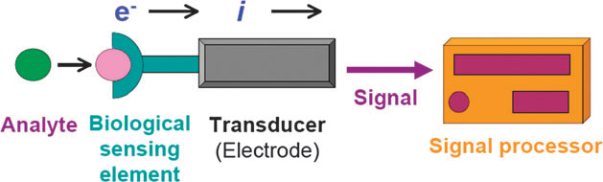
What are Biosensors?
Analyte = Target being measured
Biological sensing element = What the target binds to (DNA, enzyme, antibody)
Transducer = Converts the binding/catalysis event into a measurable signal
Signal Processor = Quantifies and displays result
Ronkainen et al, Chemical Society Reviews, 2010
Verma, Applied Project Defense. June 2011

Slide 23
Redox Probe as an Electron Mediator
Glucose
Glucose
e⁻
O₂
e⁻
O₂
GOx
GOx
H₂O₂
H₂O₂
Glucono-1,5-lactone
Glucono-1,5-lactone
Fe(CN)₆⁻³
Fe(CN)₆⁻⁴
Sensor
Unmediated Reaction
Sensor
Mediated Reaction
[Fe(CN)₆]⁴⁻ [Fe(CN)₆]³⁻ + e⁻
Ferrocyanide (strong reducing agent) being oxidize to ferricyanide
La Belle, E. Chem. 101. 2011.

Slide 24
Background: EIS Equivalent Circuit Models
Circuit Model
Nyquist Plot
Decreasing ω
Randles Circuit
-Im(Z)
R_{ct}
R_{s}
R_{s}
Re(Z)
R_{s} + R_{ct}
C_{d}
Warburg Circuit
R_{ct}
Z
-Im(Z)
Kinetic
Diffusion
R_{s}
R_{s}
Re(Z)
R_{s} + R_{ct}
C_{d}
Verma, Applied Project Defense. June 2011
Notes:
Rs- Resistance of electron flow in the solution
Ret- Resistance for electrons to traverse from protein to GDE surface (real)
Cdl- separation of charge between electrons near protein from positively charged GDE (imaginary)
Constant phase element: non-linear model for a rough surface: due to

Slide 25
Z= baseline
Z ˃ baseline
Protein Recognition Elements immobilized to Gold Working Electrode (baseline impedance as measured by blank solution)
Target binds to recognition elements, increasing impedance from baseline.

Slide 26
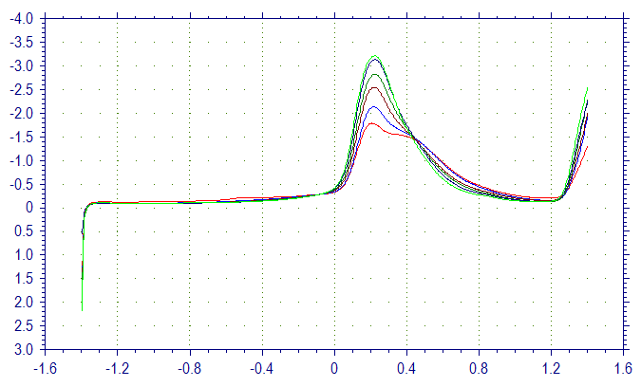
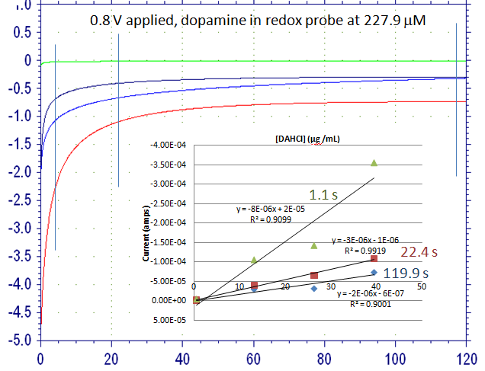
Paper 1: Electrochemical Activity of the Catecholamines
From Optimization of Experiments data:
CV, AMP-it, and SWV data for each catecholamine
What I’m missing:
Blood data for needle set up (Katherine Ruh)
Figure at Right. An AMP i-t of [DAHCl] Gradient at 0.8V potential plotting Current (0.1 mA) v. Time (s) This simulates a continuous time sensing assay.
Current (1E-04 A)
Current (1E-04 A)
Potential (V)
Figure 9. SWV assay of [NE] Gradient at 30 Hz plotting Current (0.1 mA) v. Potential (V). Essentially is a more sensitive CV.
Time (s)
Notes:
Gradient concentrations were optimized to the Molarities optimal for each assay as listed in table previously:
AMP-it: 1E-4 to 1E-6: 0.1mM to 1uM
SWV: 1E-6 to 1E-9: 1uM to 1nM

Slide 27
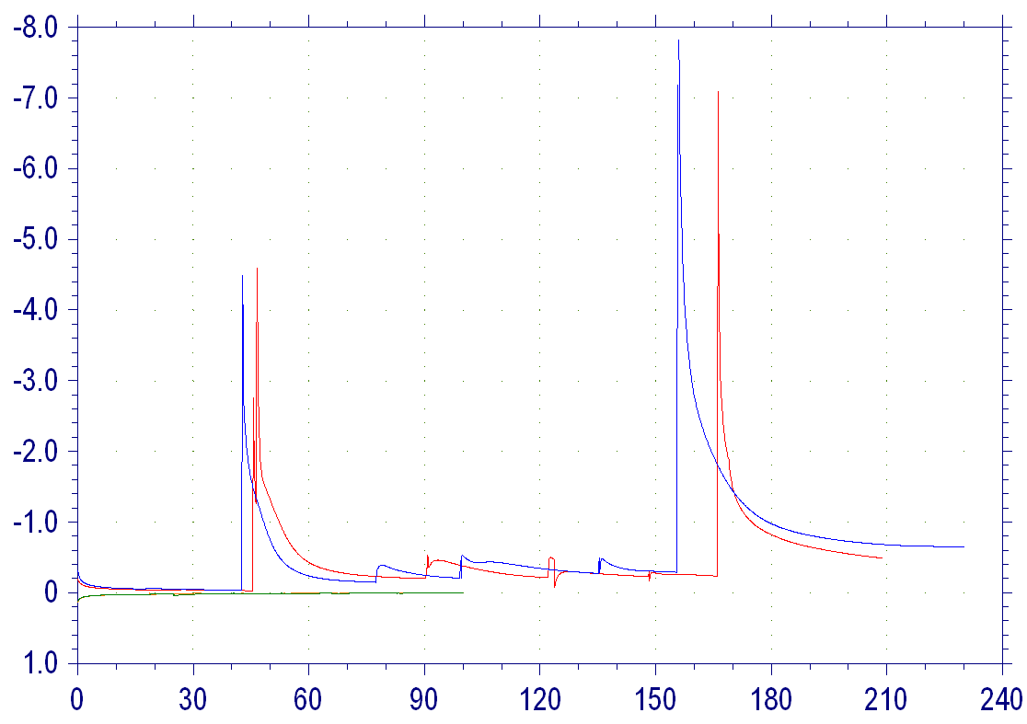
Paper 2: Enzymatic Activity of PNMT
Characterization of PNMT + Norepinephrine + SAM (co-factor)
AMP-it & CV
What I’m missing:
Replication of [NE] Gradient using AMP-it
AMP-it [NE] Gradient in blood
Figure at Left. An AMP i-t of injected [NE] Gradient with PNMT and SAM in solution at 0.49 and -0.185V potential plotting Current (0.1 mA) v. Time (s) This simulates a continuous time sensing assay.
100mM Ferricyanide + PNMT&SAM @ 0.49V
Current (1E-05 A)
100mM Ferricyanide + PNMT&SAM @ 0.49V
100mM Ferrocyanide + PNMT&SAM @ -0.185V
100mM Ferrocyanide + PNMT&SAM @ -0.185V
Time (s)
Notes:
Explain roll of the co-factor; gradients are run with co-factor + target

Slide 28
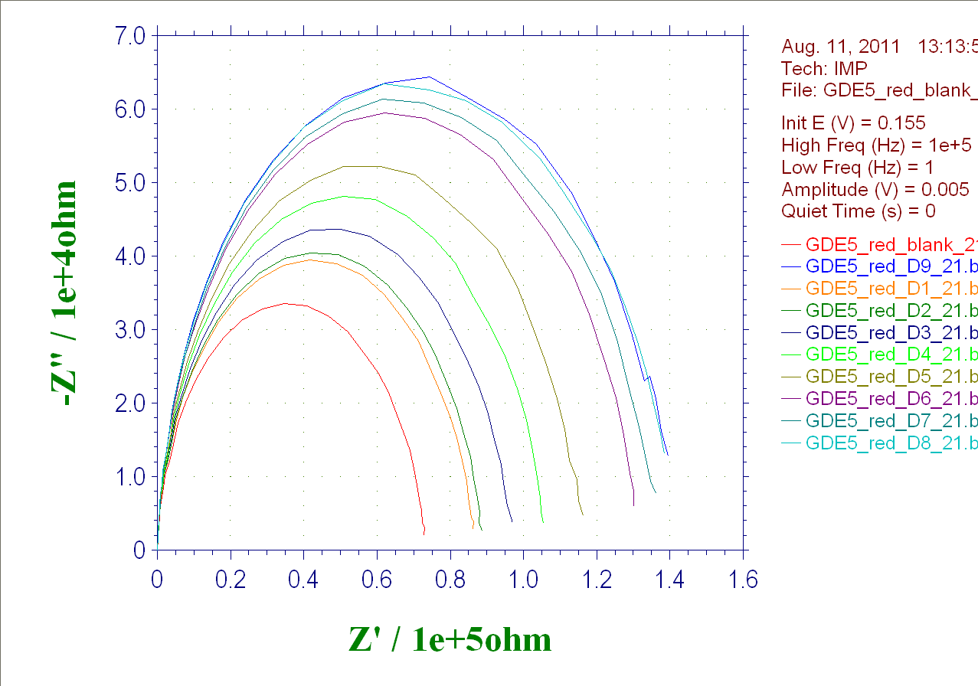
Paper 3: Protein Activity & Detection for all Catecholamines
Saving for 4+1
Using EIS to detect the catecholamines (each catecholamine has its own protein)
Hopefully, ready for integration of all catecholamines => Multiplexing
Missing data:
Characterization of proteins for Epinephrine and Dopamine
EIS for Epinephrine and Dopamine proteins
Blood EIS data
Z” (1E-4 Ohm)
D8
D9
D1
D7
Blank
D3
D4
D5
D6
D2
Z’ (1E-5 Ohm)
Figure Above. An EIS [NE & SAM] Gradient with immobilized PNMT plotting Imaginary Impedance, Z” (1E-4 ohm)v. Real Impedance, Z’ (1E-5 ohm). These Randles curves will help determine the model to determine [NE] by impedance analysis.

